Slide 1


The future starts today, not tomorrow.
www.umy.ac.id
Norman Principle
Reza Giga Isnanda, S.T., M.Sc.
Rabu, 14 Juni 2023

Slide 2
Today
Norman’s Seven Fundamental Principles of Design
Discoverability
Affordance
Signifier
Constraint
Feedback
Mapping

Slide 3
Today Learning Outcome
Mahasiswa mampu memahami Norman’s Seven Fundamental Principles of Design
Mahasiswa mampu mengidentifikasi bagaimana Norman’s Seven Fundamental Principles of Design diterapkan dalam desain

Slide 4


Slide 5


Slide 6
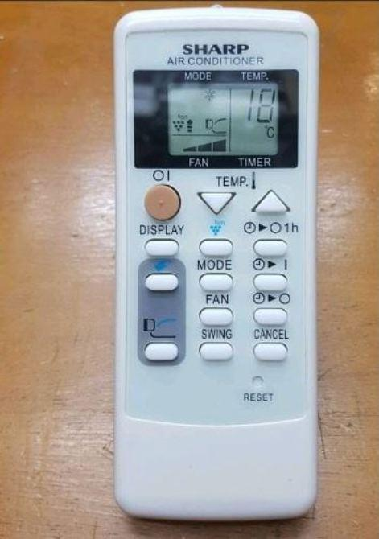

Slide 7

25º C

Slide 9
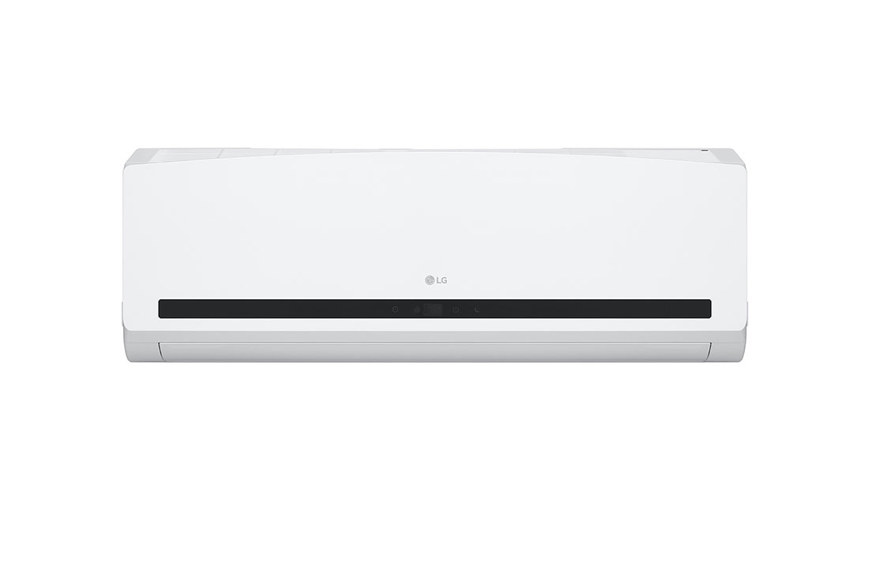

Slide 12
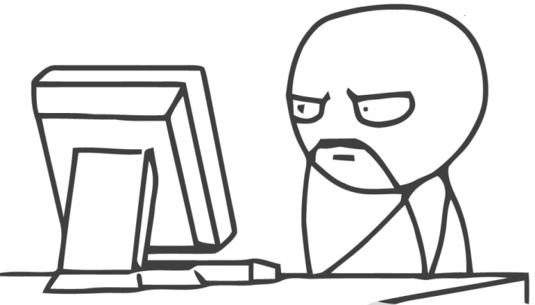
Gulf of execution
Human
Computer
Gulf of evaluation

Slide 13
“ it’s okay if you make mistake in the first try
it’s okay if you have to read a manual or ask someone to teach you
but it’s not okay if you have to do the same thing twice”
Notes:
Tidak masalah jika anda salah di percobaan pertama.
Tidak masalah jika anda harus membaca buku atau minta diajarkan seseorang.
Tapi akan jadi masalah jika anda harus melakukan hal yang sama untuk kedua kalinya “

Slide 14
How to help User?
Make the interaction
Easy and Intuitive

Slide 15
Norman’s
Seven Fundamental
Principles of Design

Slide 16
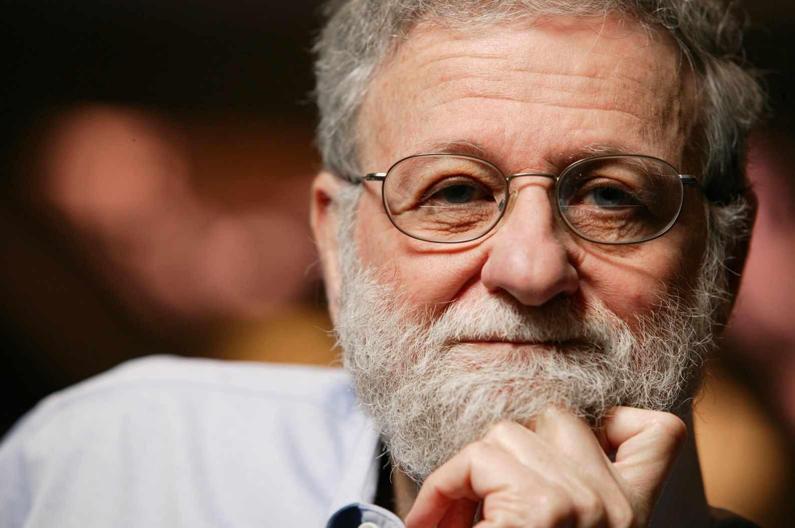
Norman’s Principle
Notes:
Norman’s Seven Fundamental Principles of Design terdapat dalam buku The Design Of Everyday Things
Norman’s principle dibuat untuk membantu mendesain produk, tidak harus sistem interaktif
Formal Education: Teknik Elektro (S1 di MIT dan S2 di Pennsylvania) dan Psikologi (S3 di Pennsylvania)
Professor of Cognitive Science & Psychology, emeritus, University of California, San Diego. (1993 – present)
Direktur di Design Lab di University of California, San Diego (2014 – present)
Co-founder Nielsen Norman group (1998 – present)
(We help companies move toward human-centered products and internet interaction, the better to play a major role in the new world of customer-centered goods and services)
The Nielsen Norman group shares a common goal: by focusing upon people, we create products and services that enhance customer satisfaction, that maintain relationships, and increase sales.

Slide 17
For Donald Norman
good design is defined by
Discoverability + Understanding
Notes:
Discoverability: Is it possible to even figure out what actions are possible and where and how to perform them?
Understanding: What does it all mean? How is the product supposed to be used? What do all the different controls and settings mean?

Slide 18


Slide 19
Norman Doors

Slide 20
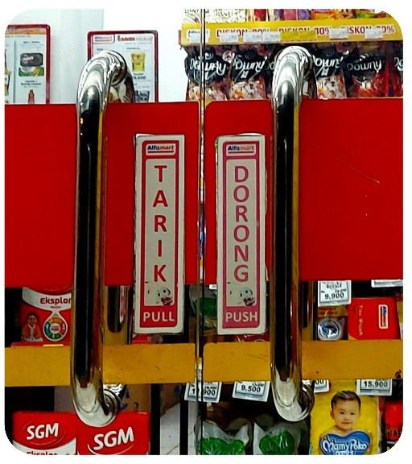

Slide 21
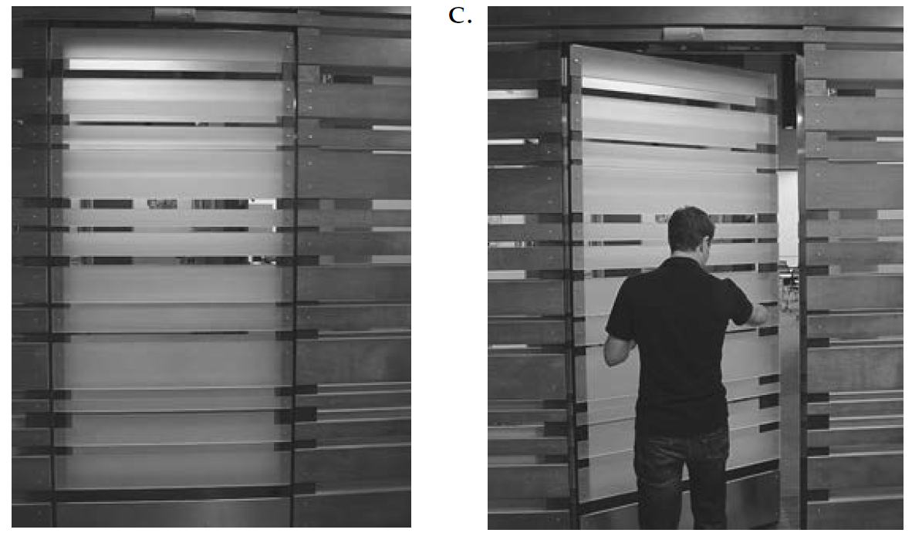

Slide 22
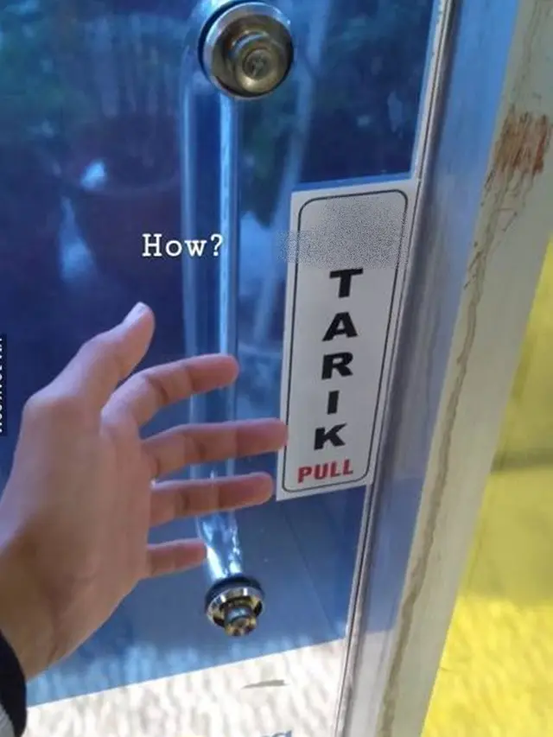

Slide 23
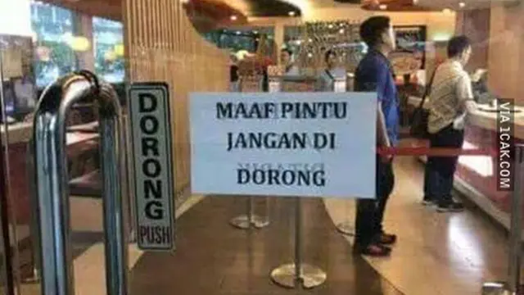

Slide 24
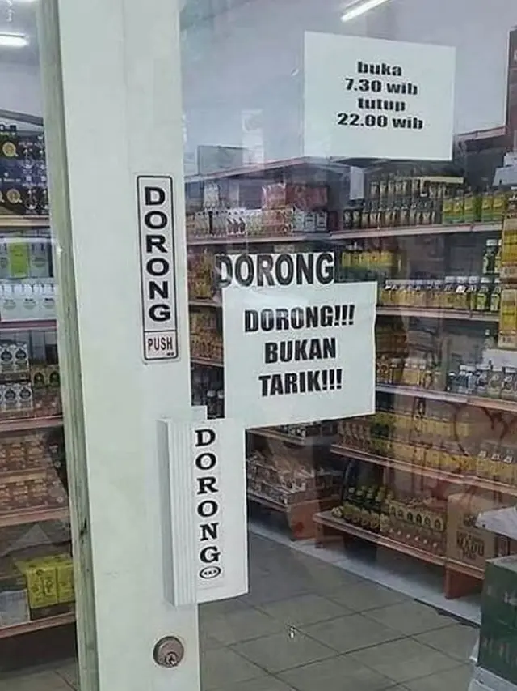

Slide 25
For Donald Norman
good design is defined by
Discoverability + Understanding
Notes:
Discoverability: Is it possible to even figure out what actions are possible and where and how to perform them?
Understanding: What does it all mean? How is the product supposed to be used? What do all the different controls and settings mean?

Slide 26
Norman’s Principle
Norman’s Seven Fundamental Principles of Design terdiri atas:
Conceptual Model
Discoverability
Affordance
Signifier
Constraint
Feedback
Mapping

Slide 27
Conceptual Model

Slide 28


Notes:
Mengarahkan mental model user ke model yang diinginkan

Slide 29
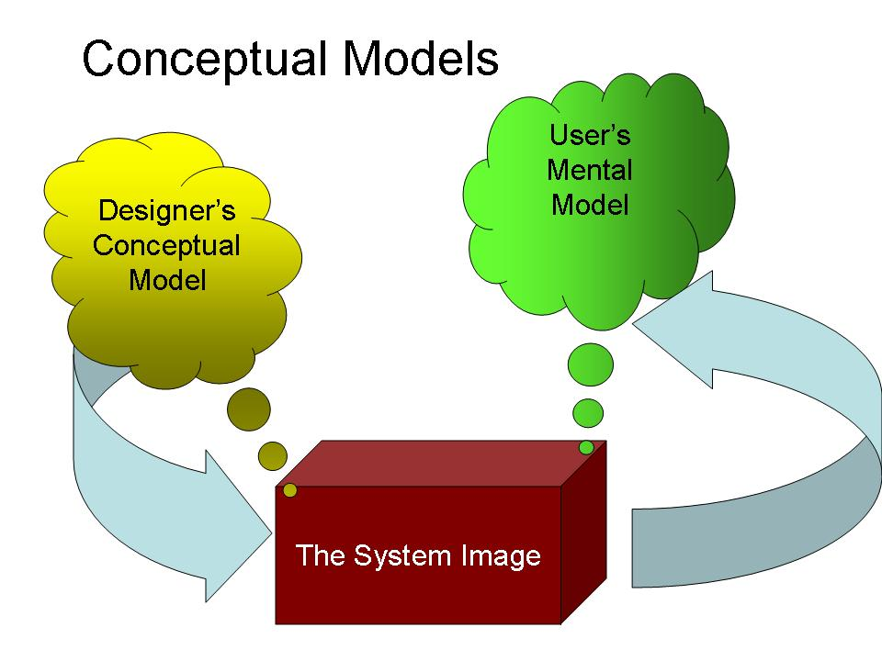
Notes:
Ini gambar yang tepat.
Conceptual model: model milik designer mengenai konsep kerja sistem
Mental model: model asumsi user mengenai cara kerja sistem
System image: interface sistem yang diciptakan designer dan yang sesungguhnya dilihat dan digunakan oleh user. System image menyangkut produk beserta manual, help, dan lain-lain
Designer berinteraksi dengan user melalui system image.
For people to use a product successfully, they must have the same mental model (the user's model) as that of the designer (the designer's model).
But the designer only talks to the user via the product itself, so the entire communication must take place through the "system image": the information conveyed by the physical product itself.
So, basically, all of the other 6 fundamental principles of design feed into the conceptual model that the user creates in their mind of how this thing is supposed to work.
If all of these principles are done well (e.g. naturalistic mapping, discoverable affordances, etc), then the conceptual model the user forms will be very similar to the one the designers had in mind and they will use the product correctly and effectively.
However, when there is a disconnect between the conceptual model of the designer and that of the user, that is when trouble can occur
The design projects all the information needed to create a good conceptual model of the system, leading to understanding and a feeling of control.
The conceptual model enhances both discoverability and evaluation of results.

Slide 30
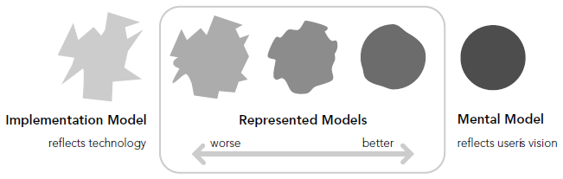
Notes:
Mana tugas programmer
Mana tugas designer → membuat antaramuka yang mendekati mental model user, bukan implementation model
Mana tugas user
Jadi mental model user dipengaruhi oleh seberapa bagus informasi mengenai sistem dipresentasikan ke user

Slide 31
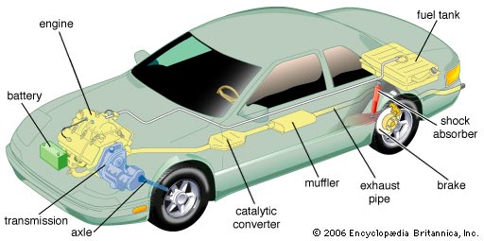
Conceptual Model

Slide 32
Conceptual Model
Gas → bergerak
Rem → melambat
Kopling + Perseneling → ganti gigi
Setir → belok

Slide 33
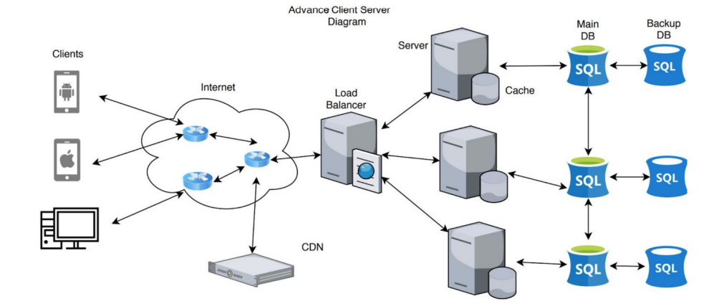
Conceptual Model

Slide 34
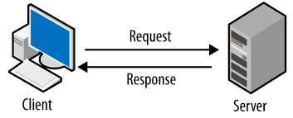
Conceptual Model

Slide 35
Conceptual Model
Input alamat dan nama database
Input password database
Init connection
Input query
Terima return value
Tampilkan return value

Slide 36
Conceptual Model
Input data yang ingin disimpan
Klik submit
Lihat hasil

Slide 37
Simple Conceptual Model → Better Mental Model
Complicated Conceptual Model → Harder Mental Model

Slide 38
Discoverability

Slide 39
Discoverability
Easy to discover
What can I do?
What is happening?

Slide 40
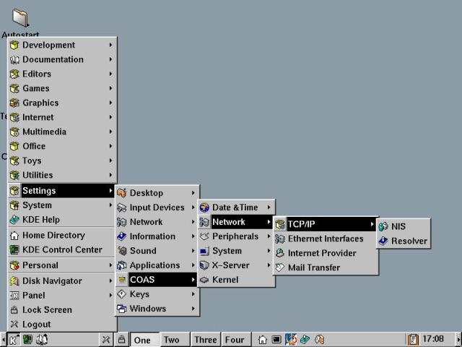

Slide 41
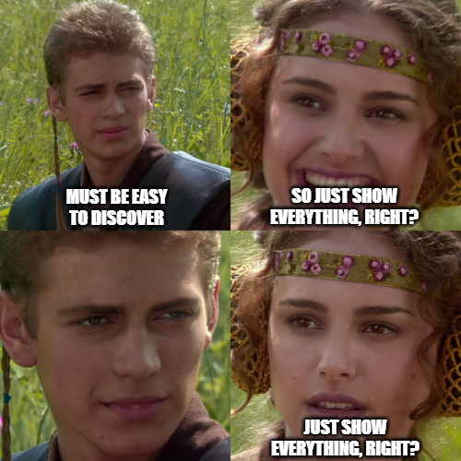

Slide 42
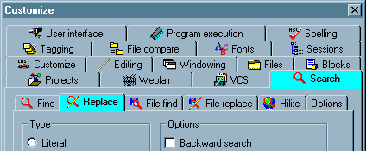

Slide 43
Most important/basic feature = easiest to find
Most important/basic output = easiest to find

Slide 44
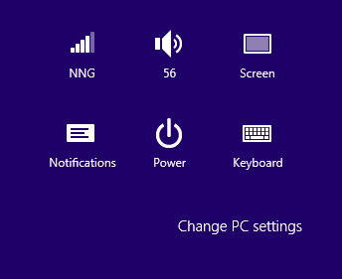

Slide 45
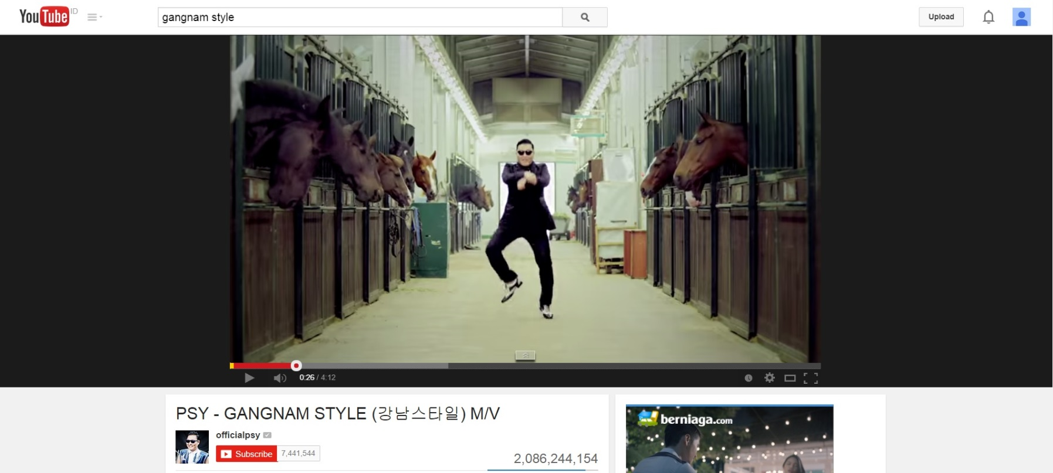

Slide 46

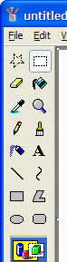
Discoverability

Slide 47
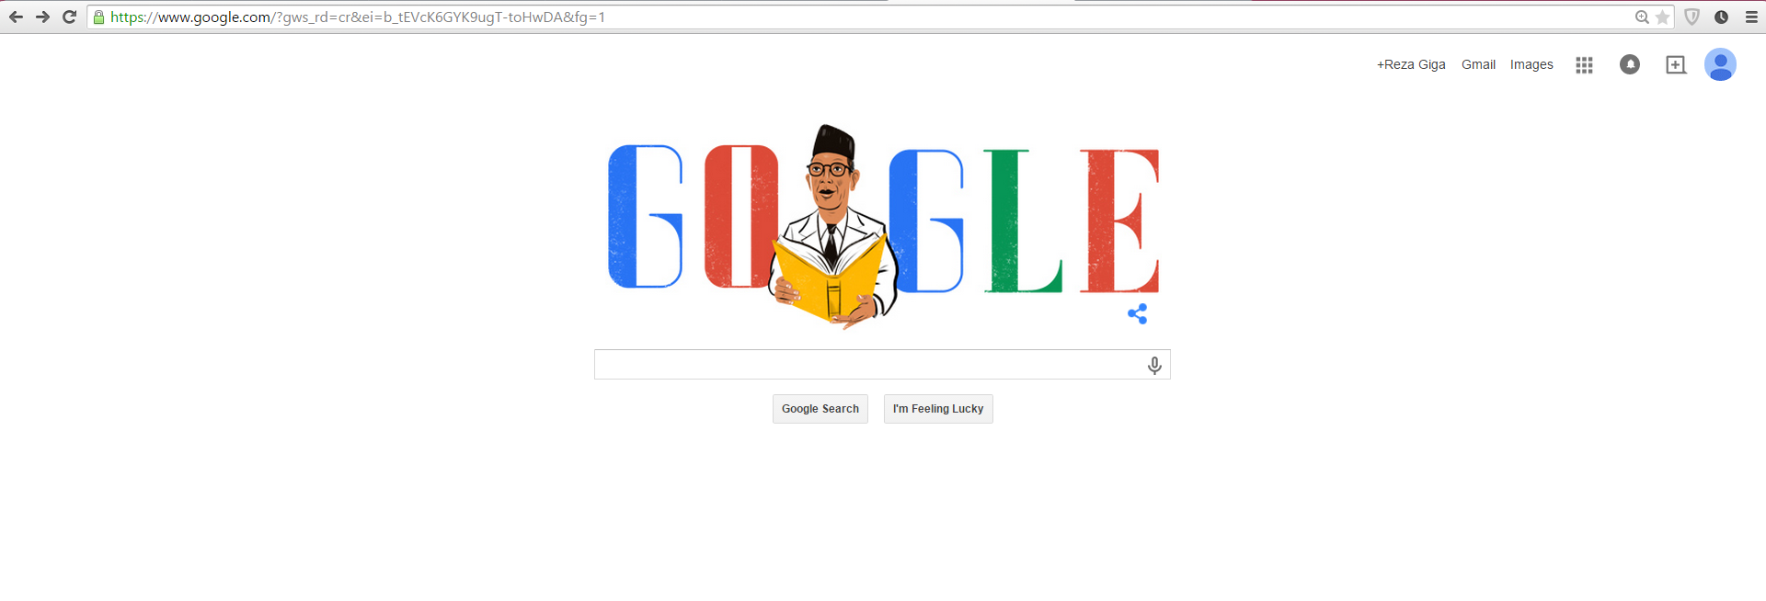

Slide 48
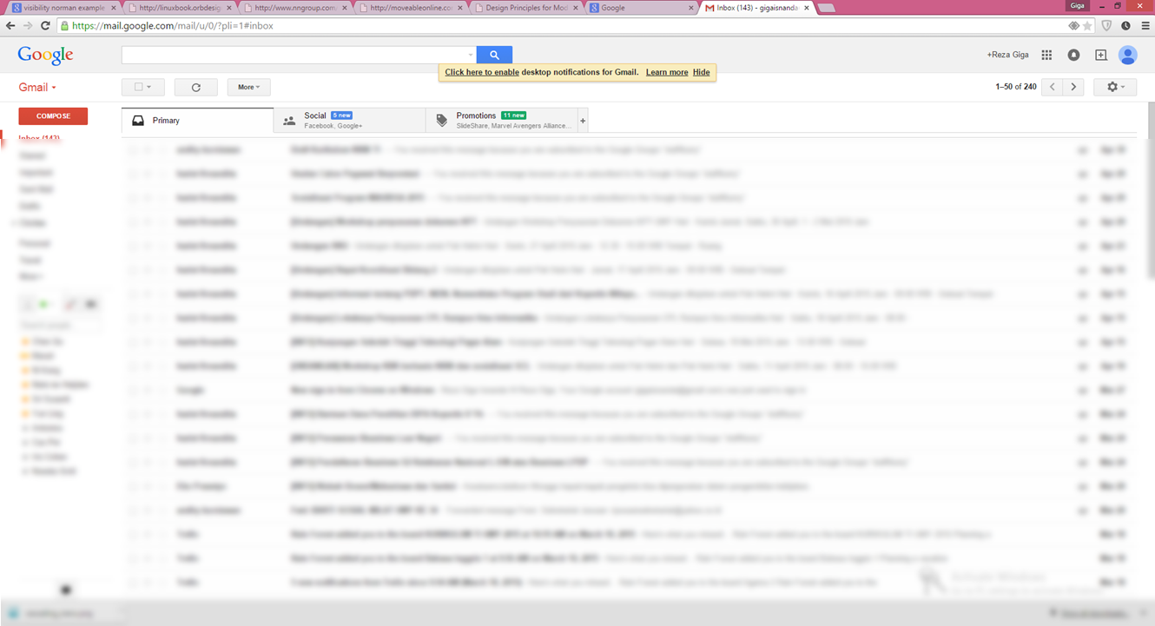

Slide 49
Affordance

Slide 50
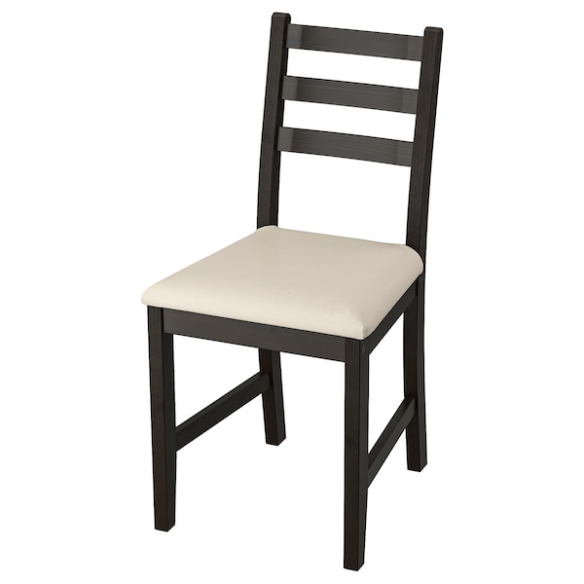

Slide 51


Slide 52
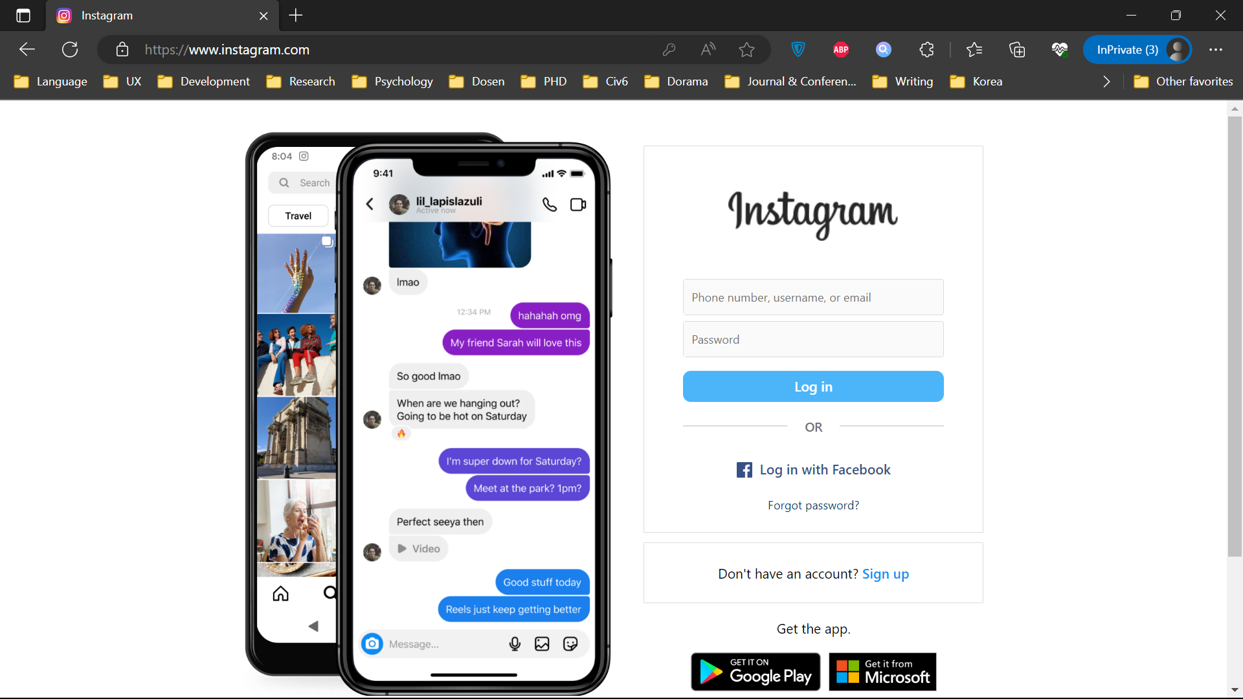

Slide 53
Affordance
HUMAN OBJECT
RELASI

Slide 54
Affordance
OBJECT
Attribute
Attribute
Attribute
Attribute
Attribute
Attribute

Slide 56


Slide 57


Slide 58
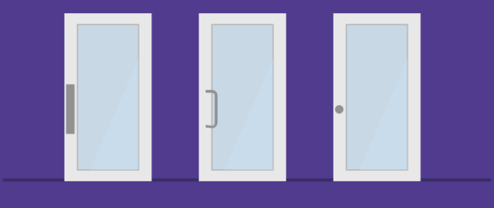

Slide 59
Affordance
Affordance talk about relation
But Affordance does not talk about the proper relation

Slide 61


Slide 62


Slide 63


Slide 64


Slide 65


Slide 66
Affordance
Jenis-jenis affordance
Actual affordance
Perceived affordance
Hidden affordance
False affordance
Notes:
Perceived affordance: affordances help people figure out what actions are possible without the need for labels or instructions.
Need some information to be perceived
Terjadi saat kita belum berinteraksi dengan object
Sangat umum di dunia komputer → layar bisa diclick/disentuh, tapi tidak semua menghasilkan reaksi
Contoh: pintu didorong atau ditarik?
Hidden affordance: Affordances exist even if they are not visible. For designers, their visibility is critical: visible affordances provide strong clues to the operations of things.
Contoh: MacGyver, Google Search, play di media player dengan click screen

Slide 67
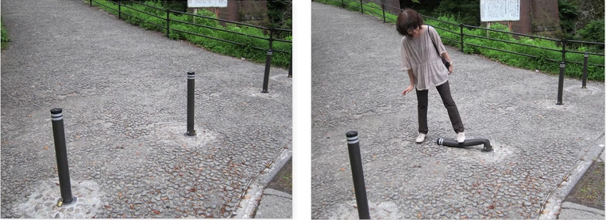
Affordance

Slide 68


Slide 69
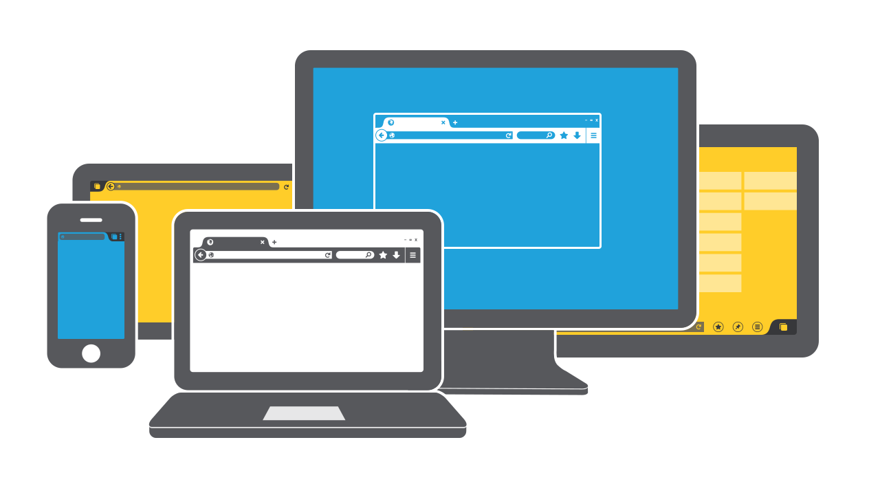

Affordance
More Difficult

Slide 70
Signifier

Slide 71
Signifier
SIGNIFIER → SIGN

Slide 72
Signifier
Affordance → what action is possible
Signifier → tool to help make affordance clear

Slide 73
Signifier
Signifier → segala petunjuk yang dapat “ditangkap” manusia (perceive) yang mengkomunikasikan affordance object (terutama yang benar)
Focus on
What?
Where?
How?

Slide 74
Signifier
Bisa berupa
Text
Simbol/gambar/icon
Warna
Suara
Lampu
Bayangan
Getaran
Apapun

Slide 75
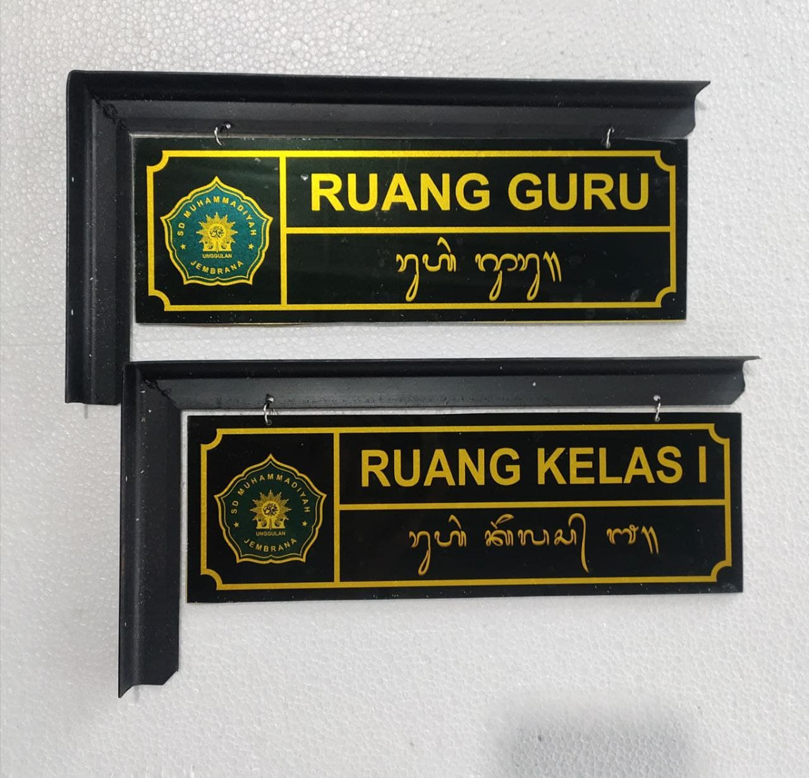

Slide 76


Slide 77
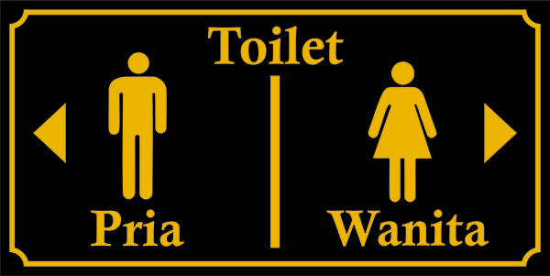

Slide 78
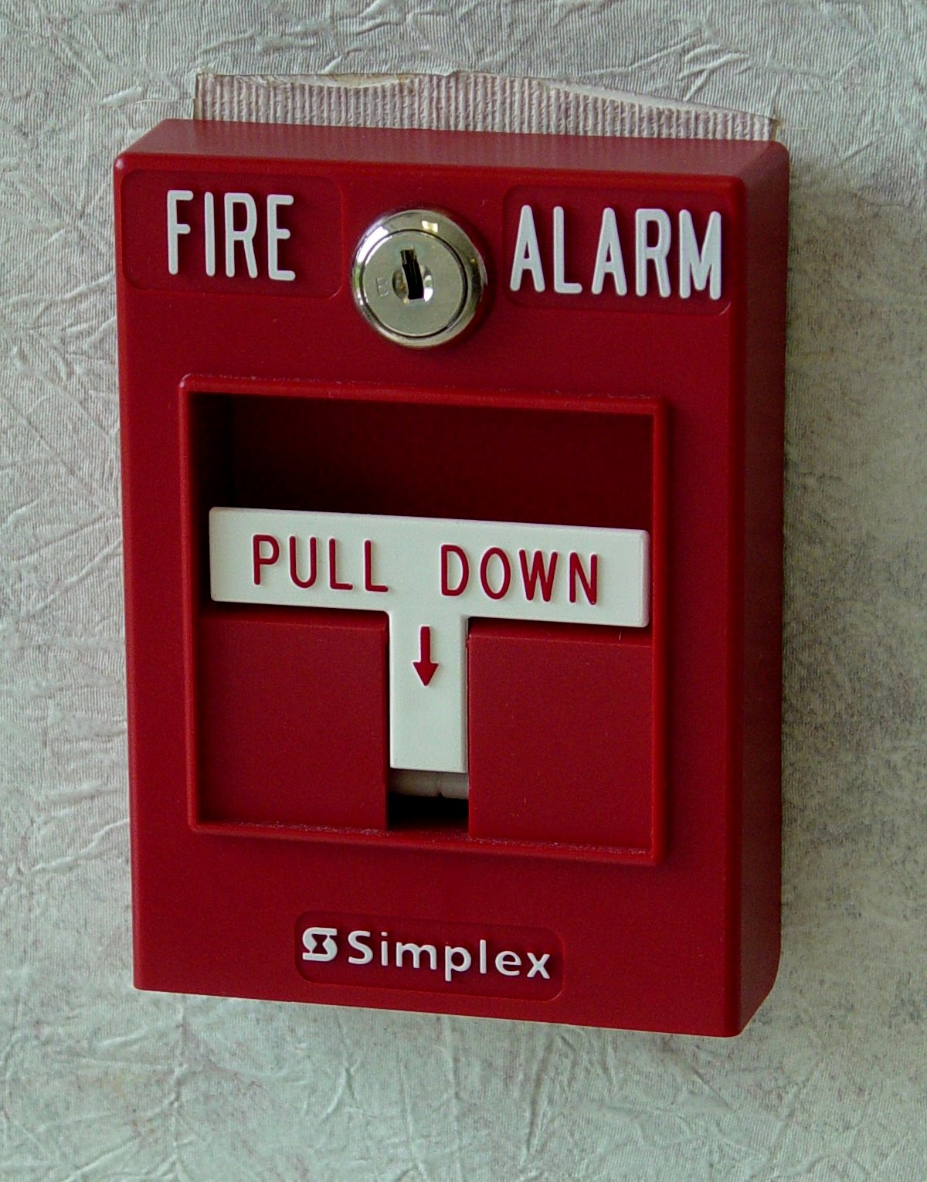

Slide 79
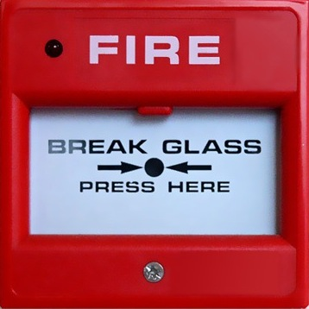

Slide 80
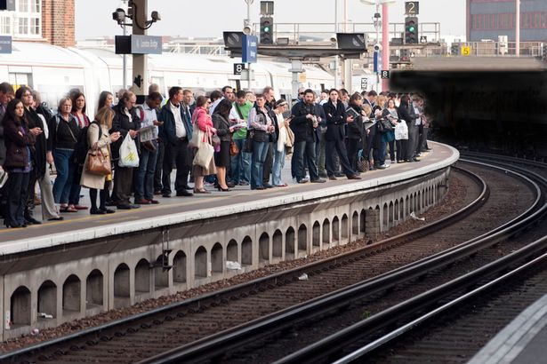

Slide 81
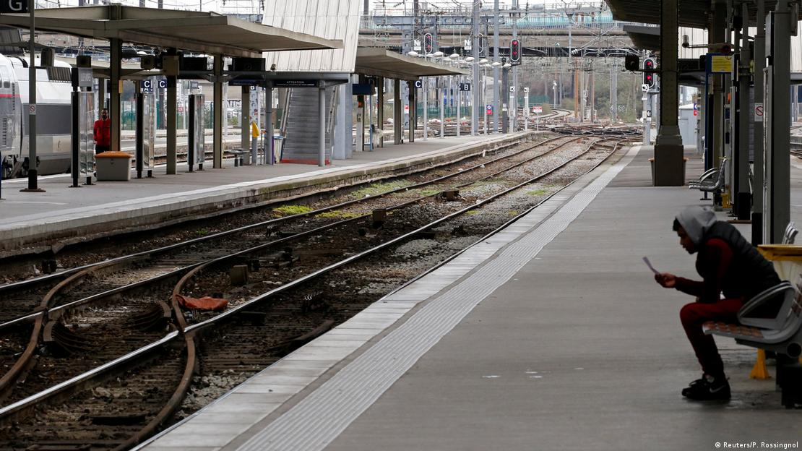

Slide 82
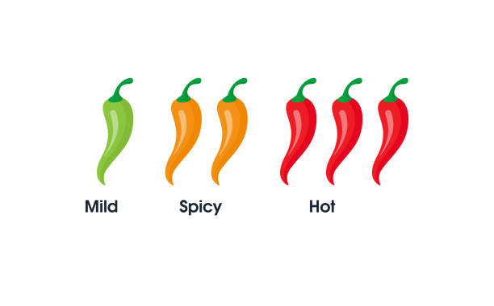

Slide 83

Signifier

Slide 84
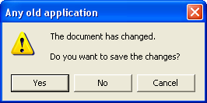
Signifier
Notes:
Contoh lain: scroll bar

Slide 85
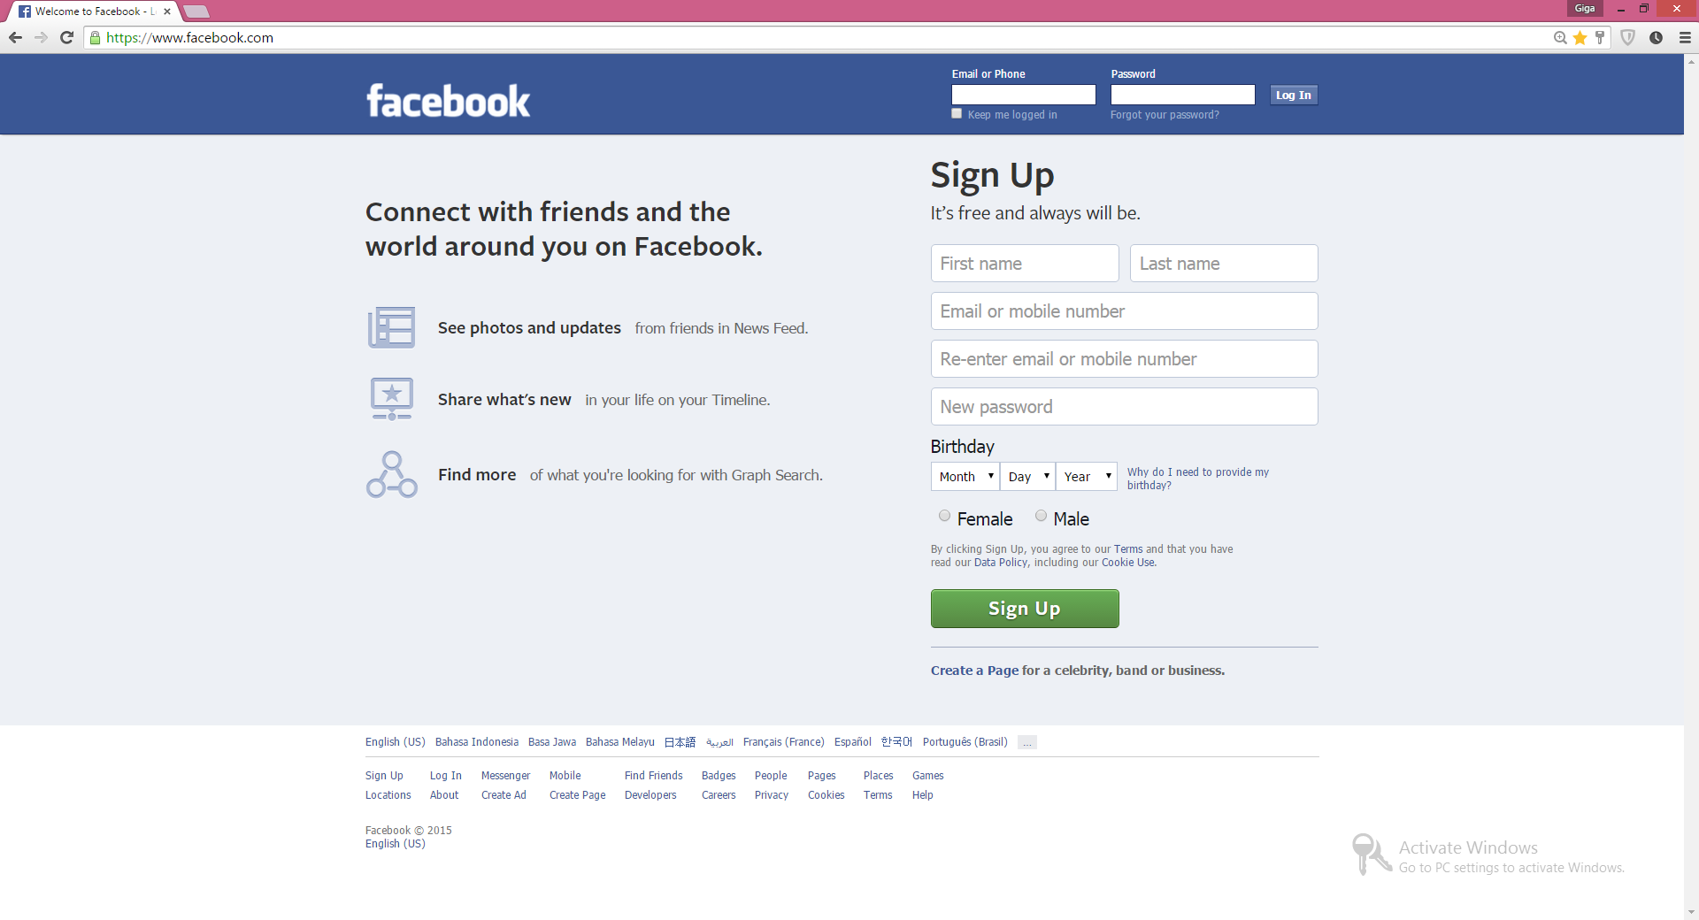

Slide 86
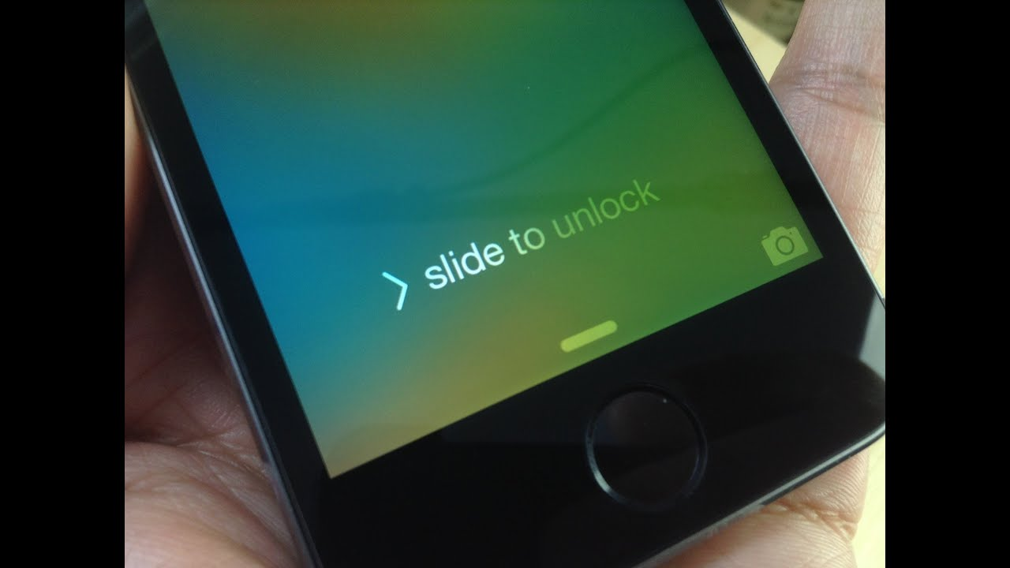

Slide 87
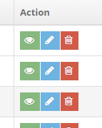

Slide 88
Constraint

Slide 89
Constraint
Signifier only communicate the affordances
But human can still make mistake, and signifier cannot prevent it

Slide 90
Constraint
Constraint limit human action
Including action that leads to error

Slide 91
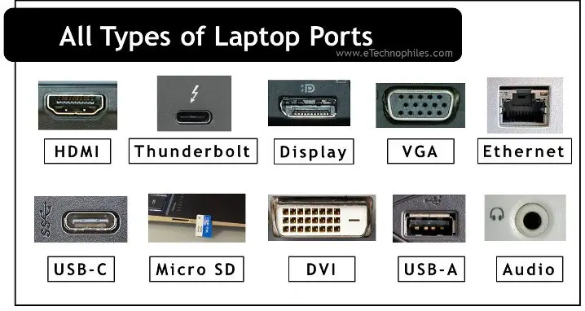

Slide 92
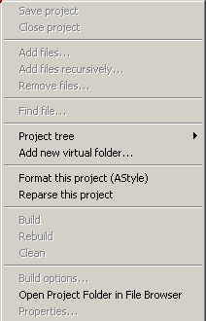

Slide 93
Constraint

Slide 94
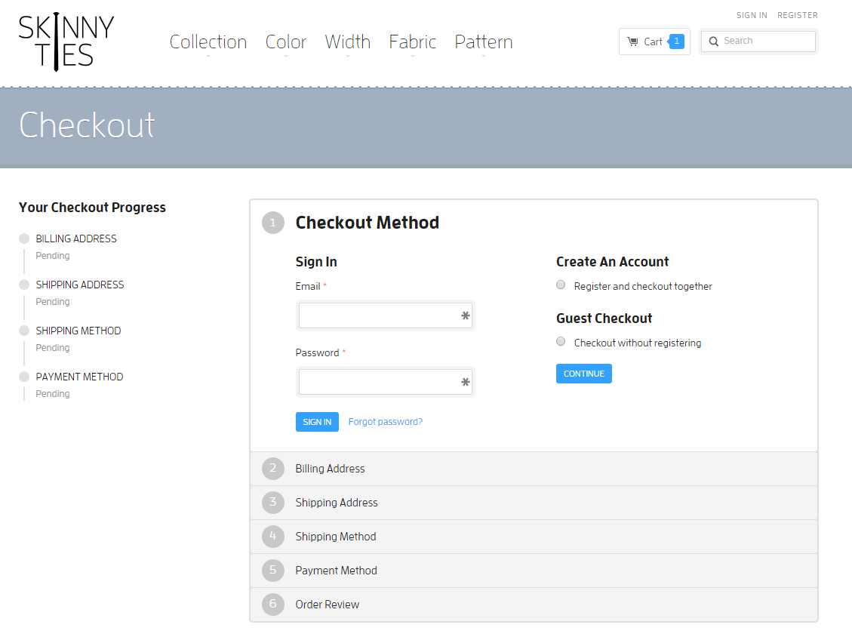

Slide 95
Feedback
Notes:
Suara mobil, kalau mobil di rem, mobil akan semakin pelan, speedmeter menunjukkan kecepatan
Good feedback allows users to answer necessary action questions such as "What happened?" and "What does it mean?" Something good to keep in mind is that feedback should not only get the user's attention to let them know something happened, but it should be specific enough that the user has all the information they need to take action.
Feedback yang baik mempermudah user mengetahui apakah intention-nya mendekati goal
Feedback yang baik mempermudah user mempelajari sistem
Pastikan feedback tidak membingungkan user

Slide 96
Feedback
Feedback → communicating the results of an action

Slide 97
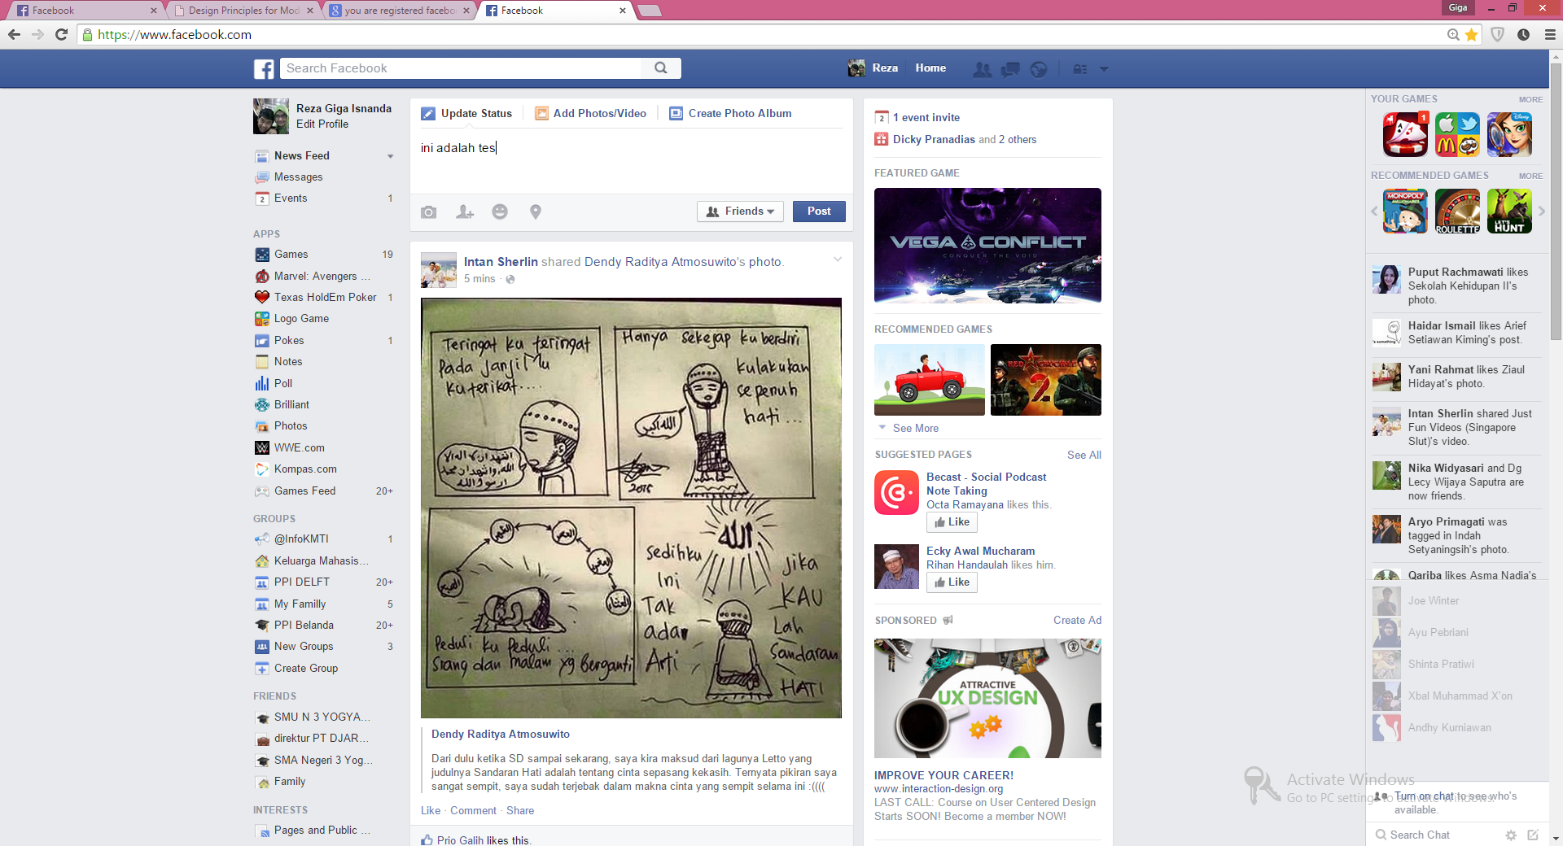
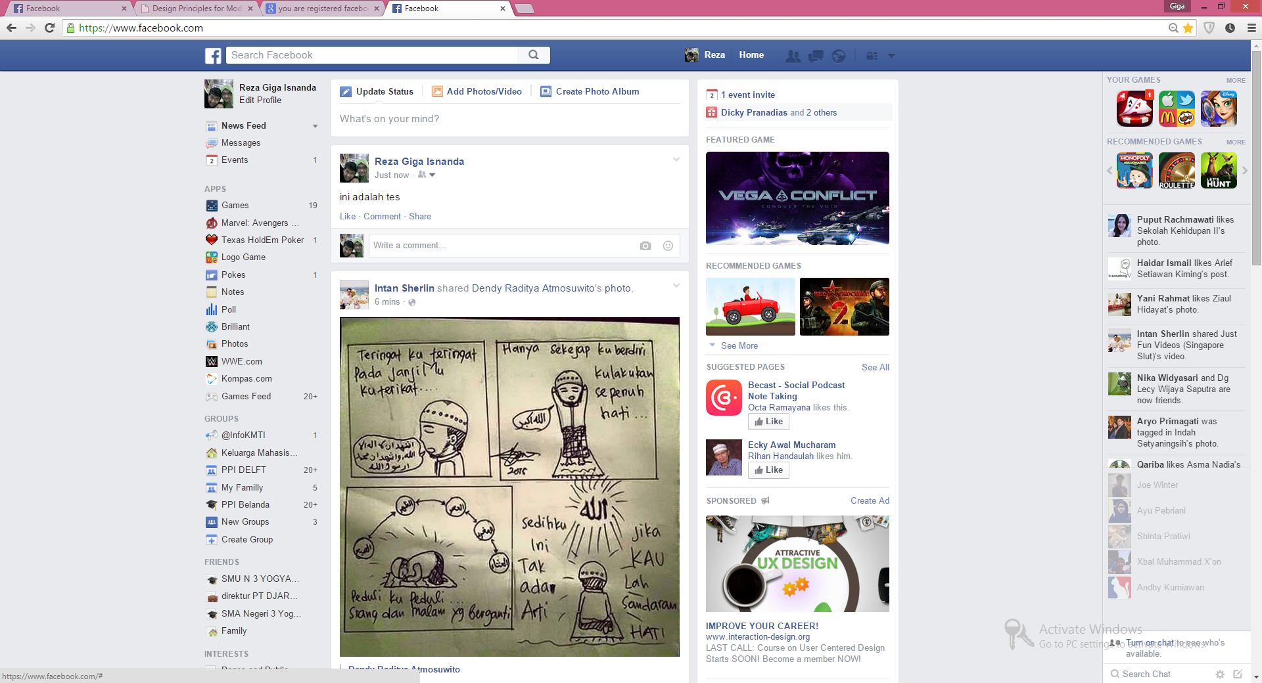

Slide 98
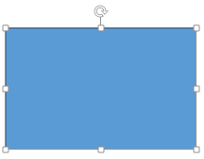
Feedback

Slide 99
Feedback
Good Feedback:
Must be perceivable
Must be understood
Immediate/Instant
Provides actual information about the system state
Shows if the action Correct or Wrong

Slide 100
Feedback
Type of feedback
Positive feedback
Negative feedback
Progress feedback

Slide 101
Feedback
Negative Feedback
I know I am wrong → good
I know why I am wrong → better
I know how to fix it → best

Slide 102
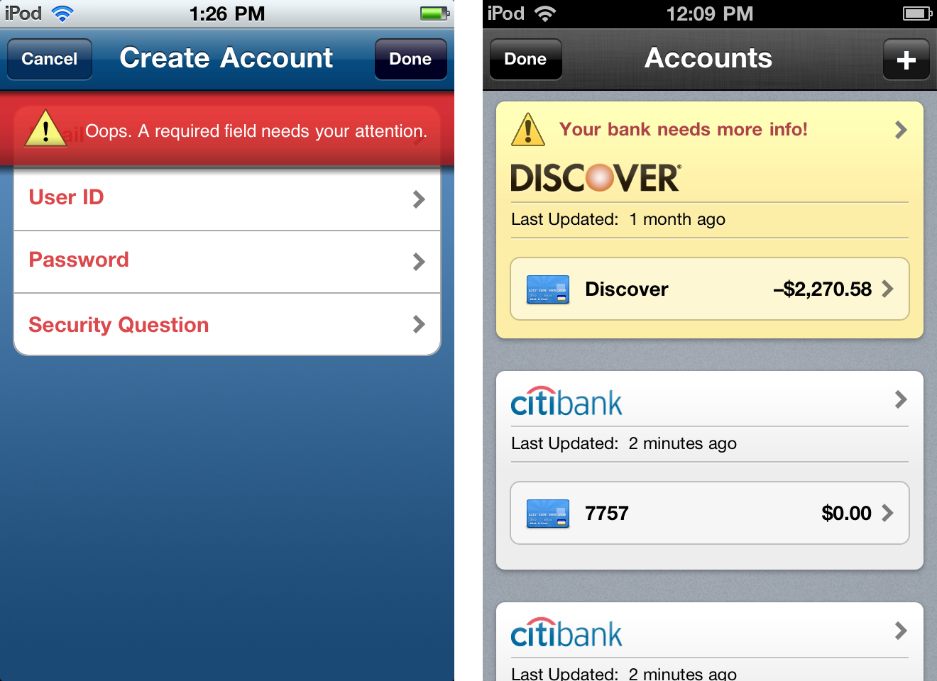
Feedback

Slide 103
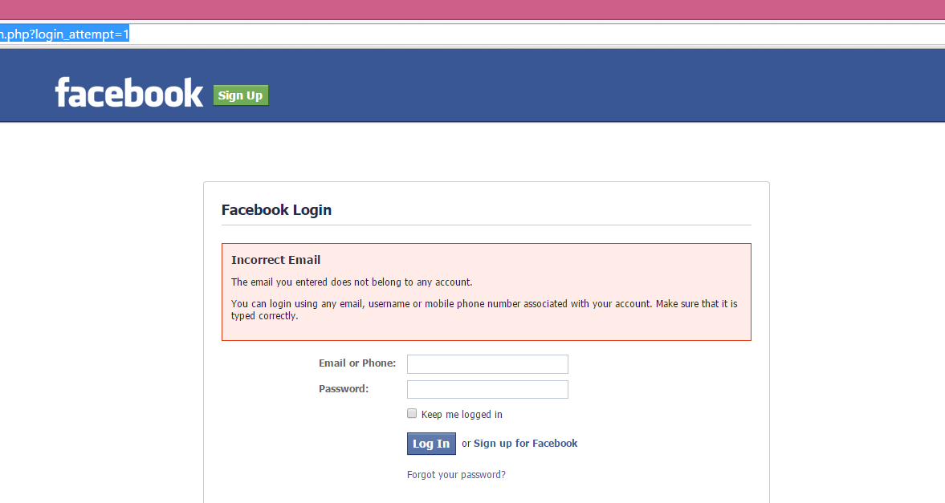
Feedback

Slide 104
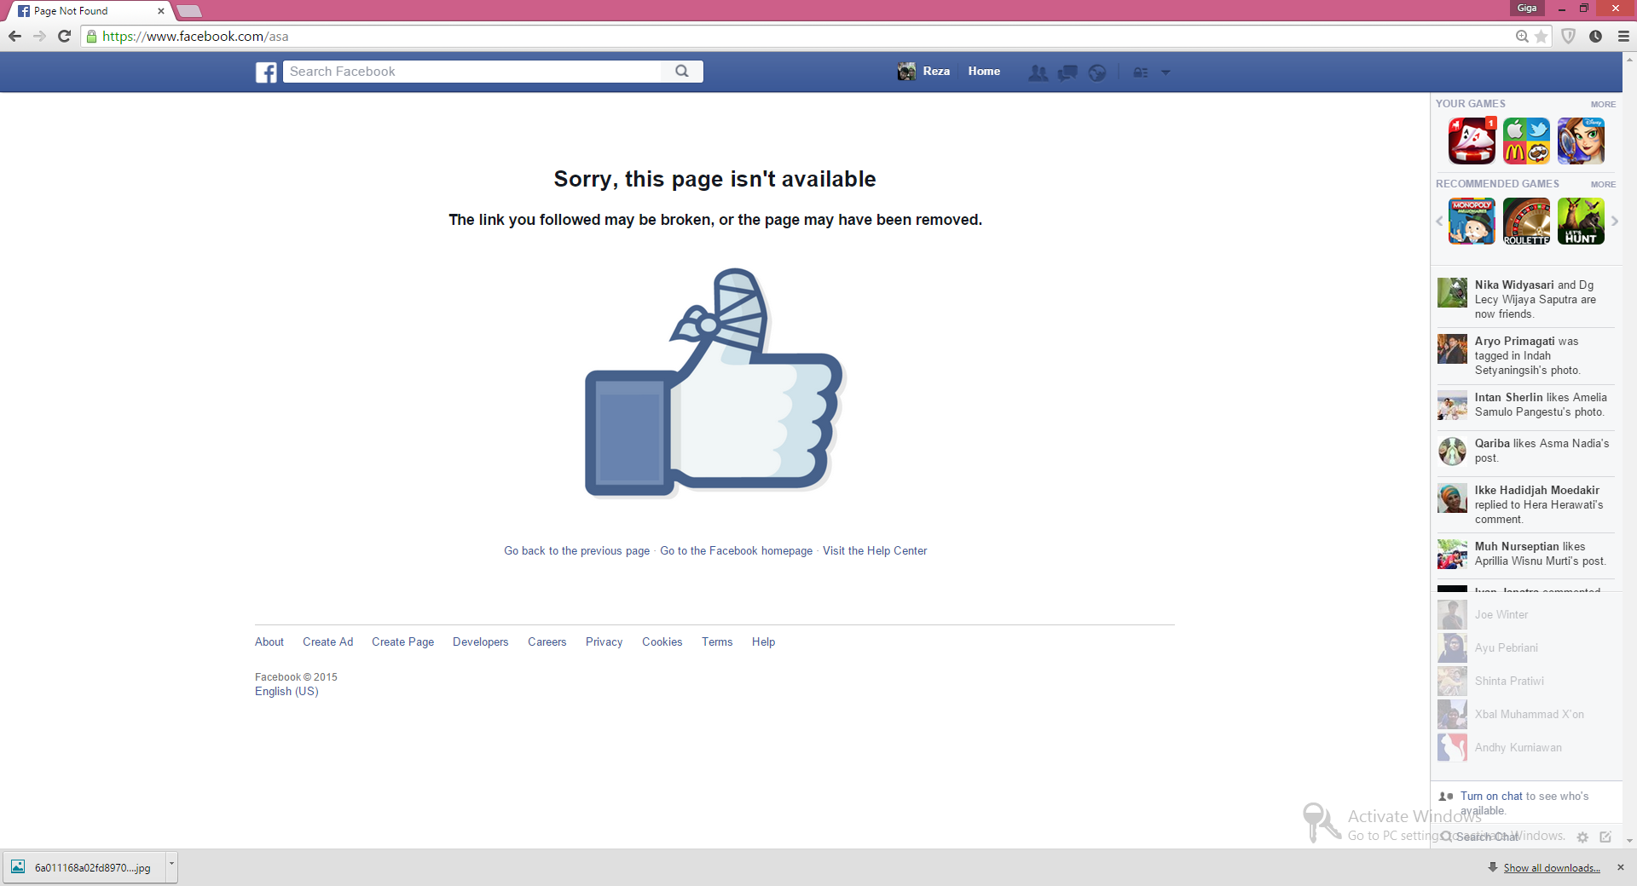
Feedback

Slide 105


Slide 106
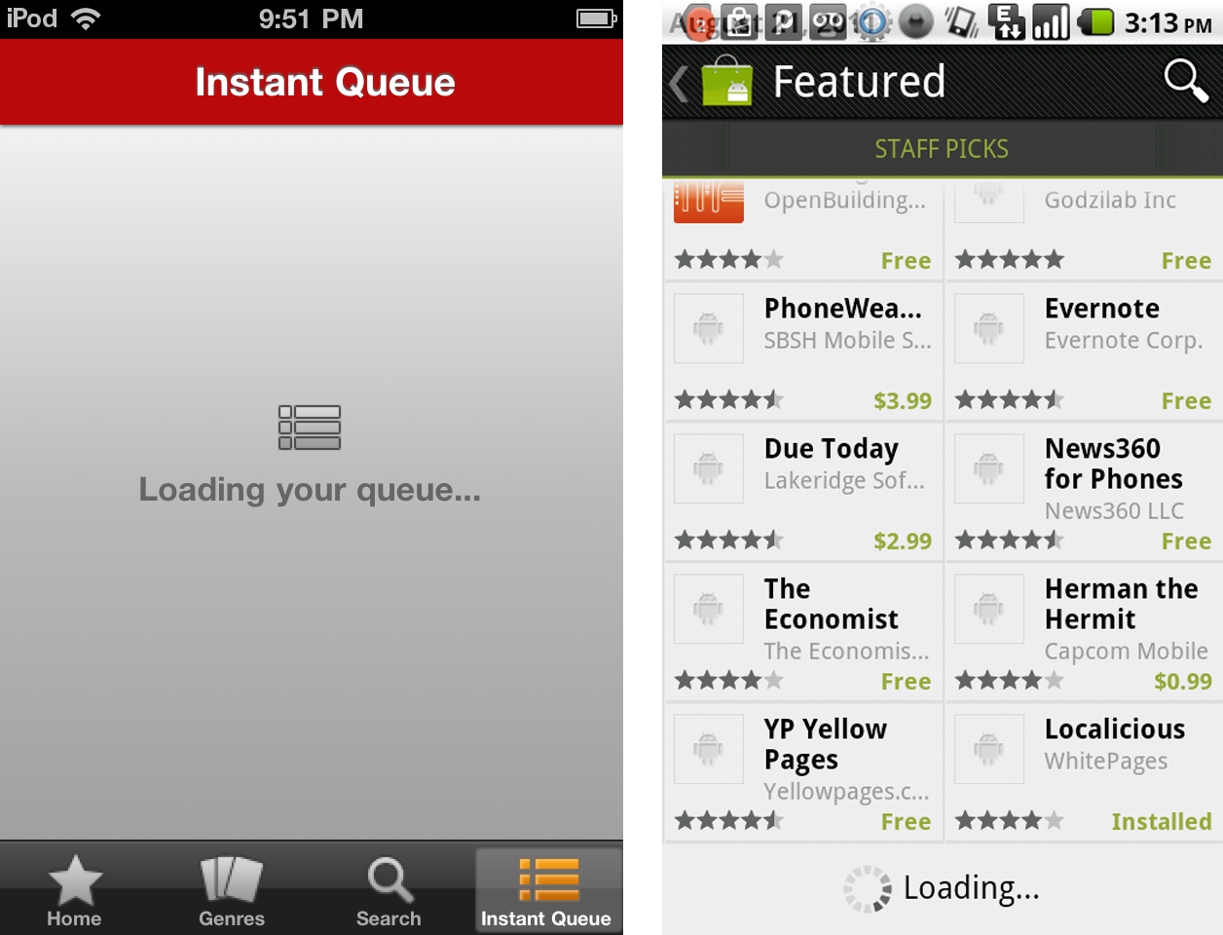
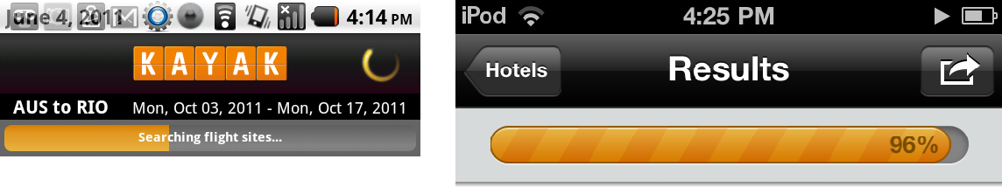

Slide 107
Mapping

Slide 108
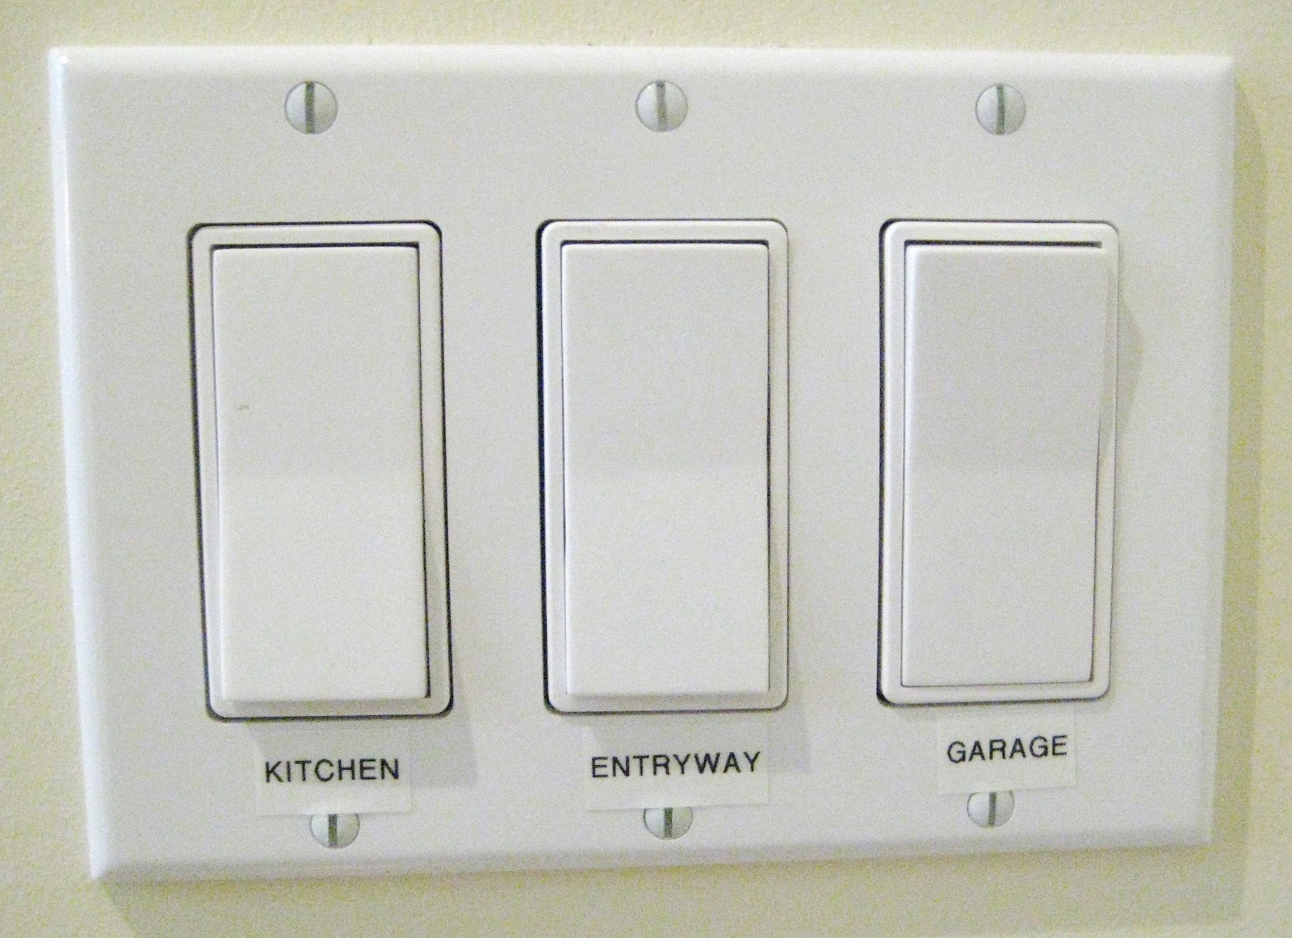

Slide 109



Slide 110



Slide 111


Slide 112
Mapping
REMOTE OBJECT
RELASI

Slide 113
Natural Mapping does not require Signifier

Slide 114


Slide 115


Slide 116


Slide 117


Slide 118



Slide 119


Slide 121


